Slide 1
Superion: Grammar-Aware Greybox Fuzzing
2019 IEEE/ACM 41st International Conference on Software Engineering (ICSE)
Junjie Wang∗, Bihuan Chen†, Lei Wei∗, Yang Liu∗‡
∗School of Computer Science and Engineering, Nanyang Technological University, Singapore
†School of Computer Science and Shanghai Key Laboratory of Data Science, Fudan University, China
‡College of Information Science, Zhejiang Sci-Tech University, China
Shared by @mrdrivingduck

Slide 2
Programs that Process Structured Inputs
Feature - process inputs in stages:
Syntax parsing
Semantic checking
Application execution
e.g.
compilers, language interpreter (JavaScript),
browsers (CSS, XML), databases (SQL) …
AFL ?

Slide 3
The General Workflow of AFL

Slide 4
Trimming
Less search space for mutation
Same
Coverage
For unstructured binary input
For highly-structured input
Syntax
Error !!!

Slide 5
Mutation
For unstructured binary input (byte flip)
Syntax
Error !!!
For highly-structured input

Slide 6
Motivation
AFL: Grammar-unaware
Superion: Grammar-aware
Grammar-aware trimming
Minimize input while keeping syntax correct
Grammar-aware mutation
Trigger new coverage while keeping syntax correct

Slide 7
Grammar-Aware Trimming Strategy
AFL: split the input into length/n chunks
n from 16 to 1024
<?xml version="1.0" encoding="UTF-8"?>
<plist version="1.0">
<dict>
<key>Some ASCII string</key>
<string></string>
<data>
</data>
</dict>
</plist>
libplist (an XML engine)
Same coverage
Destroyed grammar

Slide 8
Grammar-Aware Trimming Strategy
Superion
Input + Grammar → AST (if error, use AFL trimming)
Trim a subtree n from tree
Test coverage
Trimming until no sub-tree can be trimmed

Slide 9
Grammar-Aware Trimming Strategy
…
try{eval("\nbreak M;\n");} catch(ex){}
try{…}catch(ex){}
try{eval("if(\"\"){}else if(x4) {null;}");} catch(ex){}
try{eval("{}");} catch(ex){}
try{eval("for(var x = x in x - /x/ ){}");} catch(ex){}
…

Slide 10
Grammar-Aware Mutation Strategies:
Enhanced Dictionary-Based Mutation
AFL’s dictionary-based mutation:
Insert
Overwrite

Slide 11
Grammar-Aware Mutation Strategies:
Enhanced Dictionary-Based Mutation
Superion’s dictionary-based mutation:
Locate the token boundaries
Alphabets + digits (variable/function names, reserved keywords)
Insert only to each boundaries
Overwrite only tokens between two boundaries

Slide 12
Grammar-Aware Mutation Strategies:
Enhanced Dictionary-Based Mutation
Greatly decreases the number of token insertions/overwrites
Maintains the structure of mutated test inputs
Effectiveness + efficiency
…
a = 0x1
a = 0const1
…
…
a = 0x1
const a = 01
…
…
a = 0x1
a = 01
…
…
a = 0x1
a = 01
…
…
a = 0x1
a = 0+
…
…
a = 0x1
a + 01
…

Slide 13
Grammar-Aware Mutation Strategies:
Tree-Based Mutation
Treeify the test input I into AST
Treeify another random input into AST
Extract all sub-tree into a set S
Replace each sub-tree in I with each sub-tree in S

Slide 14
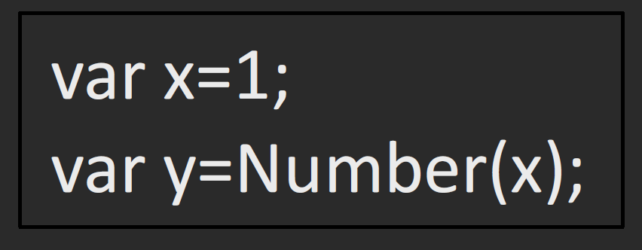
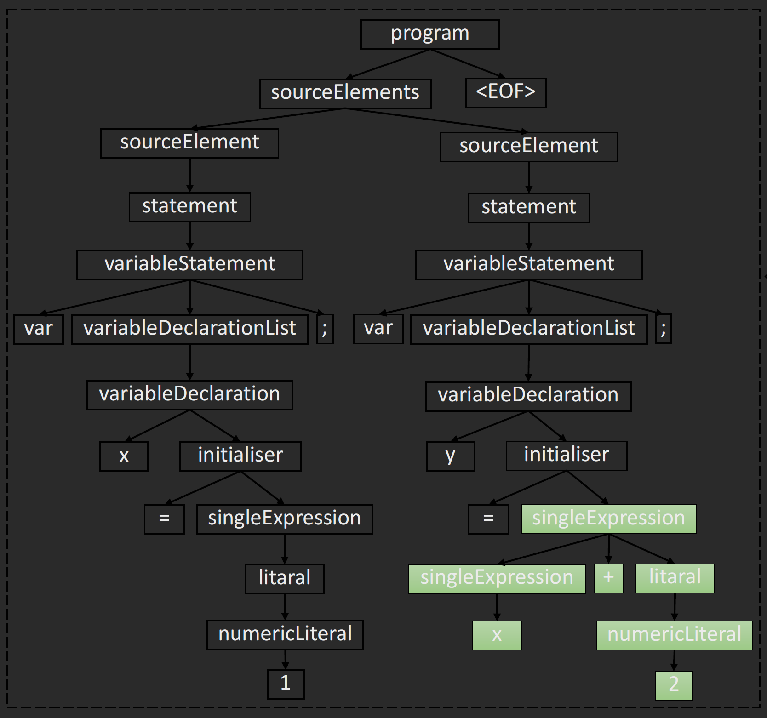
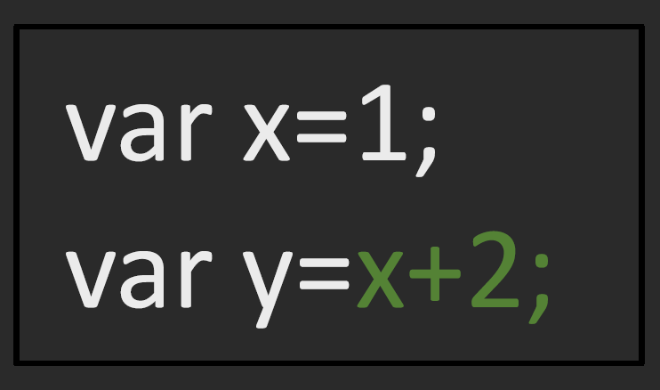
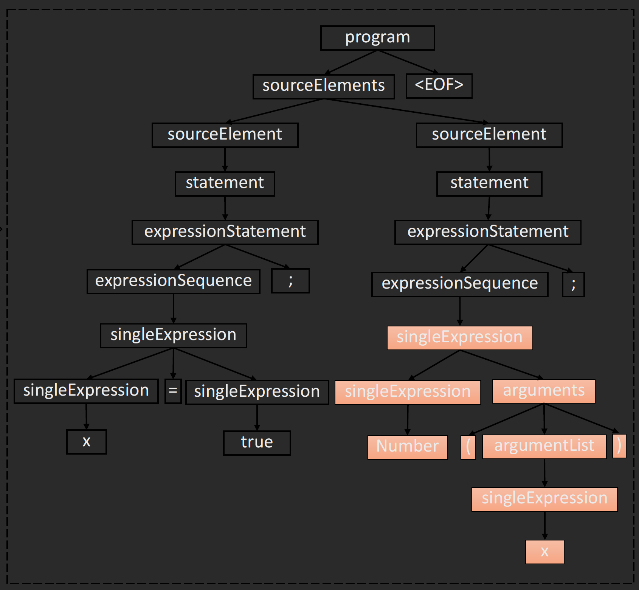
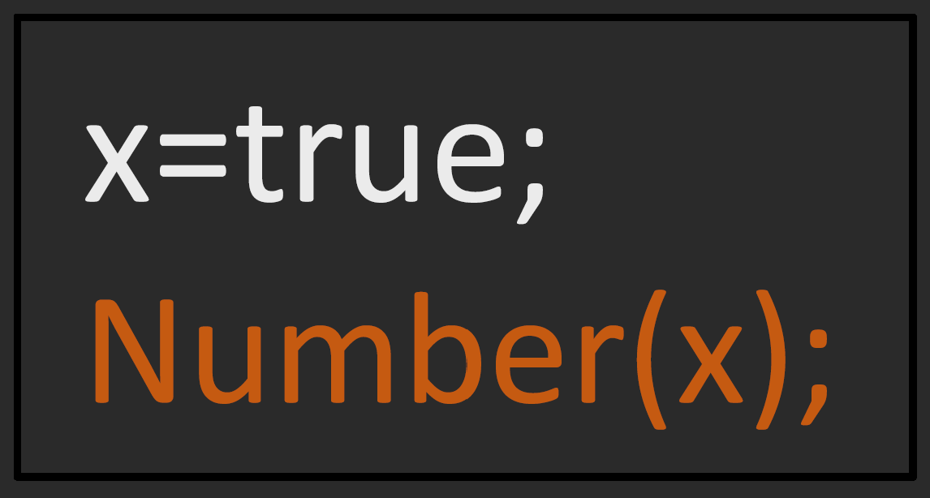
Grammar-Aware Mutation Strategies:
Tree-Based Mutation

Slide 15
Evaluation
Extending AFL with 3,372 lines of C/C++ code
1 open-source XML engine
3 open-source JavaScript engine

Slide 16
Evaluation - How is the bug-finding capability of Superion?
34 new bugs
22 new vulnerabilities with 19 CVE identifiers assigned

Slide 17
Evaluation - How is the code coverage of Superion?
Improve 16.7% in line coverage
Improve 8.8% in function coverage

Slide 18
Evaluation - How effective is our grammar-aware trimming?
Relatively low trimming ratio
Improve the grammar validity ratio after trimming

Slide 19
Evaluation - How effective is our grammar-aware mutation?
Effective in generating test inputs that trigger new coverage

Slide 20
Evaluation - What is the performance overhead of Superion?
Introduces additional overhead due to our grammar-aware tree-based mutation strategy
Still acceptable considering the improved bug-finding capability and code coverage

Slide 21
Limitation
Superion needs a user-provided grammar
Proprietary grammars
Undocumented extensions to standard grammars

Slide 22
Grimoire: Synthesizing Structure while Fuzzing (USENIX Security 2019)
No program input specifications
Slower than grammar-aware fuzzers
Input generalization
Input mutation

Slide 23
Grimoire: Synthesizing Structure while Fuzzing (USENIX Security 2019)
Input generalization
if(x>1) then x=3 end
if(x>1)□then □end
if(x>1)
then
end
Fragmentation
Byte chunks
Splitter
() [] {} <>
General input + tokens

Slide 24
Grimoire: Synthesizing Structure while Fuzzing (USENIX Security 2019)
Input Mutation
□ if(x>1)□then □end □
□ pprint □
if(x>1) then pprint x end
if(key>1) then pprint key end
Input extension
Recursive replacement
String replacement

